Slide 1
COVID-19 VACCINES IN CALIFORNIA & THEIR IMPACTS
Group 8 Team Members:
Becky McLaughlin
Danielle Martin
Jonathan Tran
Scott Schneider
5/3/2021

Slide 2
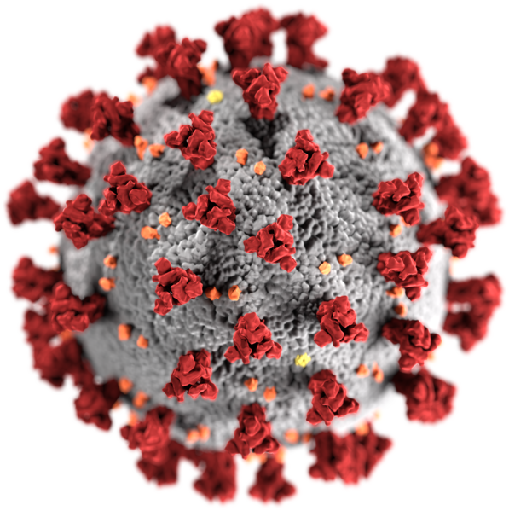
SUMMARY
This project tracks the Covid-19 vaccines in California and how the introduction of these vaccines has impacted the number and severity of cases.
We will look deeper into certain areas to determine if there are any surge causing counties or vaccine deserts in California. Finally, we will attempt to predict when California restrictions will ease by extrapolating the existing data.
Hypothesis:
Vaccines have directly impacted California’s case and death rates.
College counties had an impact on Covid-19 surges in 2020.

Slide 3
Questions & Data
How has the introduction of the Covid vaccine affected case/death rate in California?
Case count vs. Vaccine
Death count vs. Vaccine
Hospital bed availability
Do “College” counties play a larger role in case surges?
College towns vs. Case count (Heat map)
Did a county's Covid-19 case numbers affect it's vaccination rates?
Geographic distribution of counties giving more/less vaccines
Vaccination rate per 100,000 people
Vaccine to Case ratio
Can we predict when California will return to “normal”?
Cases/Vaccinations
Regression
Extrapolate line to find when California will reach the appropriate number of cases per day

Slide 4
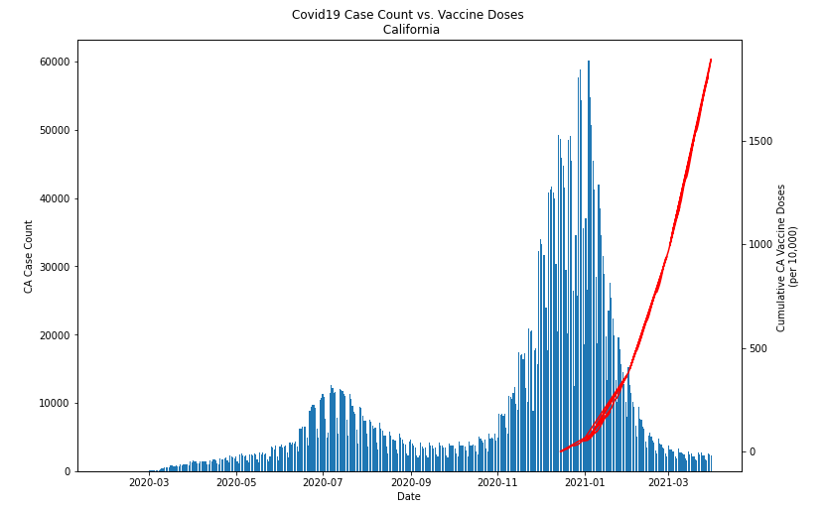
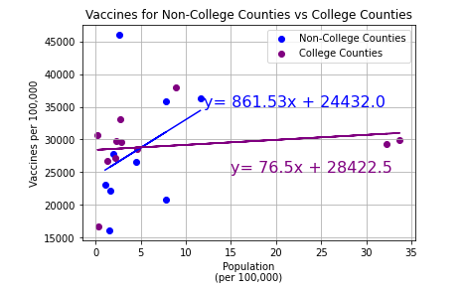
Goals for q2
Data analysis
Data Cleanup & Exploration
Data Analysis Process
Notes:
Go to Jupyter Notebooks to discuss

Slide 5
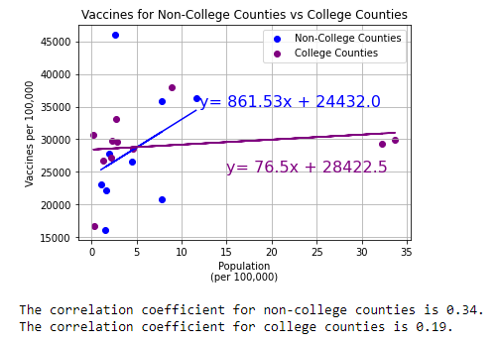
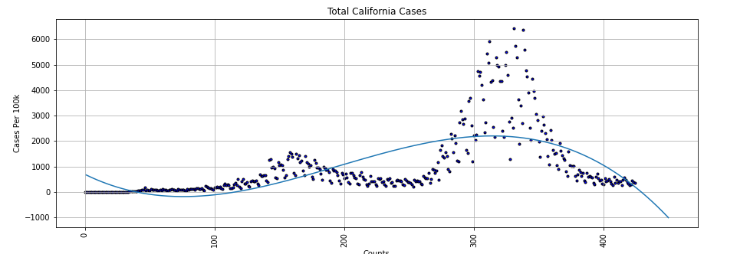
Findings
Vaccines played an integral part in reducing case & death counts, however it is difficult to determine how much of an impact as case counts were decreasing while vaccinations were just starting to roll out. These could be a result of multiple factors:
Increased restrictions
Less travel after holidays
School closures
College counties appeared to fare worse than non-college counties:
Cases/100,000 actually decrease for non-college counties as the population increases
Populations of non-college counties appear to be getting the vaccine at an increased rate based on the drastically higher slope value of the linear regression.

Slide 6
Post Mortem
As individual contributors we struggled through the github merging process. Specifically, how to resolve conflicts on our individual terminals. More guidance on this process would be helpful.
Needed data to be more granular (e.g. zip codes). Case data focused on county however some counties are geographically larger with smaller population count.
Additional questions we’d would have liked to explore:
As we know vaccines played a role in case count decrease, what impact did other factors play into these decreases – increased restrictions, school closures, warmer weather, etc.
Additional research to look into the population makeup of these counties to find greater correlations regarding college vs. non-college counties.
Considerations when predicting Covid-19 data:
Importance of current data. Case rates quickly shift with vaccine demand, variants, and developing treatments.
Time series forecasting vs regression modelling.

Slide 7
Q & A

Slide 8
THANK YOU
COVID-19 Vaccines in California and Its Impacts
Team Members:
Becky McLaughlin
Danielle Martin
Jonathan Tran
Scott Schneider
5/3/20221

Slide 9
Sources
COVID-19 Hospital Data. California Health and Human Services Open Data Portal. (2021). https://data.chhs.ca.gov/.
Google Geocoding API. Google. https://developers.google.com/maps/documentation/geocoding/overview.
Maps JavaScript API. Google. https://developers.google.com/maps/documentation/javascript/examples/layer-heatmap.
Statewide COVID-19 Vaccines Administered By County. California Health and Human Services Open Data Portal. (2021). https://data.chhs.ca.gov/.
Statewide COVID-19 Cases Deaths Tests. California Health and Human Services Open Data Portal. (2021).
https://data.chhs.ca.gov/.
The United States Census Bureau. (2020, December 10). American Community Survey 5-Year Data (2009-2019).
https://www.census.gov/data/developers/data-sets/acs-5year.html. Selected income characteristics for California zip codesvia API
The Integrated Postsecondary Education Data System. (n.d.).
https://nces.ed.gov/ipeds/datacenter/.
COVID-19 graphic:
https://en.wikipedia.org/wiki/COVID-19

